Slide 1
PRINCIPLES OF MEASURMENTS & SENSORS
21AIE114
BATCH: B
GROUP: 3

Slide 2
GROUP MEMBERS
JAIDEV CB.EN.U4AIE21117
CHANDANA CB.EN.U4AIE21118
CHARISHMA CB.EN.U4AIE21169
PRANISH CB.EN.U4AIE21137

Slide 3
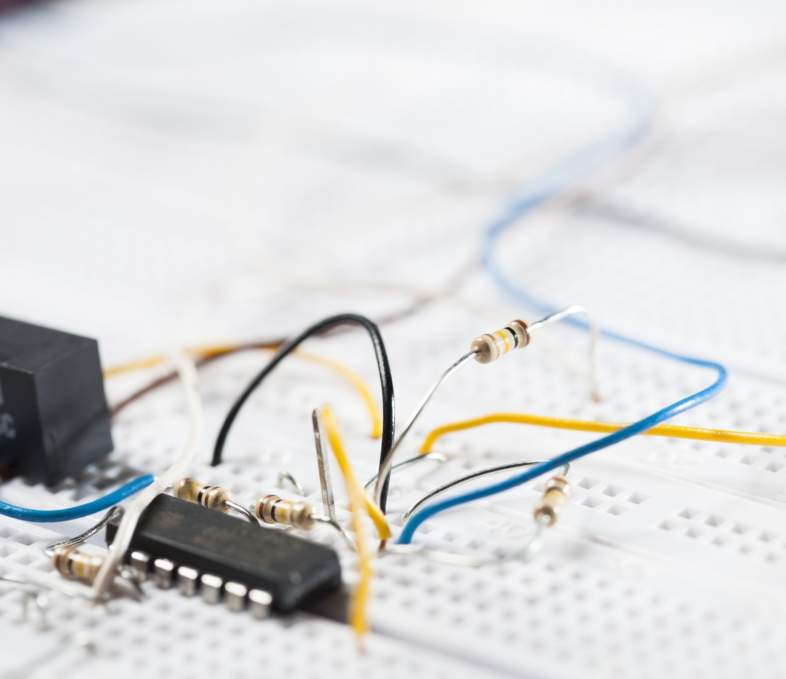
AIM
AUTOMATED SMART IRRIGATION SYSTEM USING ARDUINO

Slide 4
INTRODUCTION :
By using the concept of automated irrigation system, a farmer can save water up to 50%.
This concept depends on two irrigation methods those are: conventional irrigation methods like overhead sprinklers, flood type feeding systems i.e wet the lower leaves and stem of the plants.
The area between the crop rows become dry as the large amount of water is consumed by the flood type methods, in which case the farmer depends only on the incidental rainfalls.
To overcome these drawbacks new techniques are being adopted in the field of irrigation, through which small amounts of water applies to the parts of root zone of a plant.

Slide 5
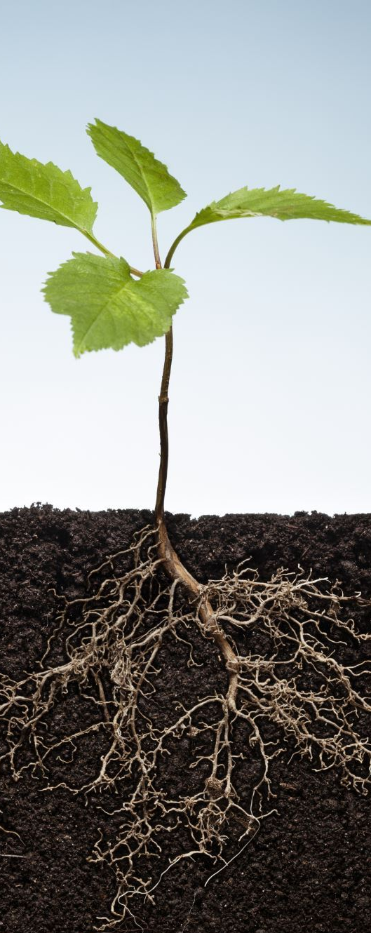
The plant soil moisture stress is prevented by providing required amount of water resources frequently or often daily by which the moisture condition of the soil will retain well.
Even more precise amounts of water can be supplied for plants. As far as the foliage is dry the plant damage due to disease and insects will be reduced, which further reduces the operating cost.
Our project on "automated Irrigation System using Arduino " is to create an automated irrigation mechanism which turns the pumping motor ON and OFF by detecting the dampness/moisture content of the soil.
This system is capable of detecting moisture content in soil using the soil moisture sensor.
Specifically, smart irrigation system using Arduino utilizes the Soil Moisture Sensor to detect moisture content in soil and give appropriate responses to the system based on detected condition.

Slide 6
OBJECTIVE :
Due to the rise in population, water scarceness happens
It's our duty to conserve water by saving it , one way by which we can save water is through this automated irrigation system .
Through this automated plant irrigation system we can conserve water since the pump gets turned on and off when it detects there is no moisture content level detected in soil.
An automated system will deliver optimum amount of water depending upon the soil moisture content.

Slide 7
The soil moisture content can be remotely monitored which eliminates the possibility of over irrigation or under irrigation.
This mainly reduces the wastage of water and also reduces the manual labour cost and saves farmers from some of the tedious field work.
This system can not only be used in farming ,but can also be used in the commercial and domestic sector like offices, workspaces and homes where there are indoor plants and lawns, the need of an automated system arises.
The system would be cheaper and more effective in maintenance of plants and lawns as compared to its human counterpart.

Slide 8
Hardware Requirements :
Arduino uno
Spark fun soil moisture sensor
Relay
Water depth level sensor
Buzzer
LED lights
Bread Board
Water pump
Arduino USB cable
Software Requirements :
Arduino IDE
Tinker Cad

Slide 9
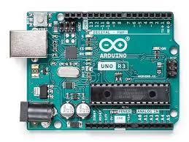
ARDUINO
It is an open-source electronics platform based on easy-to-use hardware and software. Arduino boards are able to read inputs - light on a sensor, a finger on a button, or a Twitter message - and turn it into an output - activating a motor, turning on an LED, publishing something online.

Slide 10
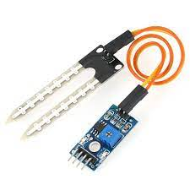
SOIL MOISTURE SENSOR & COMPARATOR
The soil moisture sensor consists of two probes that are used to measure the volumetric content of water. The two probes allow the current to pass through the soil, which gives the resistance value to measure the moisture value.

Slide 11
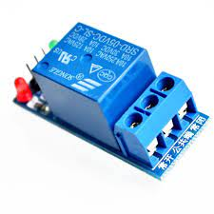
RELAY
A relay basically allows a relatively low voltage to easily control higher power circuits. A relay accomplishes this by using the 5V outputted from an Arduino pin to energize the electromagnet which in turn closes an internal, physical switch to turn on or off a higher power circuit.

Slide 12
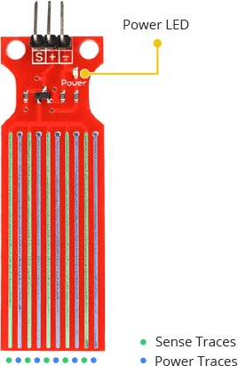
Water Depth Level Sensor
This Sensor has 10 traces, 5 are Sense traces and 5 are Power traces. This allows the sensor to detect the depth of water level by passing the current through Power traces

Slide 13
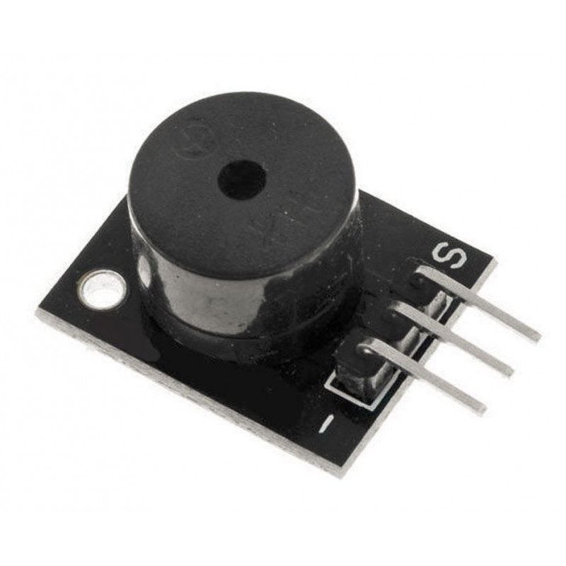
Buzzer
This sensor will make noise when water in container is going to finish

Slide 14
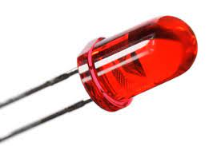
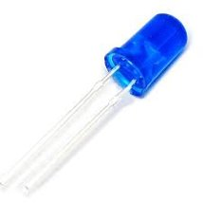
LED
LED bulbs will talk about the water content in the container. If RED glows, then the container is going to empty. If BLUE glows, then the container has enough water.

Slide 15
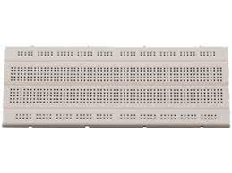
BREADBOARD
A breadboard is a solderless construction base used for developing an electronic circuit and wiring for projects with microcontroller boards like Arduino. As common as it seems, it may be daunting when first getting started with using one.

Slide 16
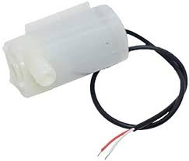
WATER PUMPING MOTOR
This is used to pump out the water connected along with relay.

Slide 17
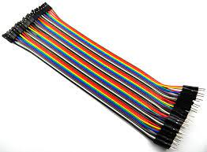
JUMPER WIRES
Jumper wires are used for making connections between items on your breadboard and your Arduino's header pins. Use them to wire up all your circuits

Slide 18
Working of soil moisture sensor :
Soil moisture sensor can,
Sense the moisture content in the soil,
Send this data to the Arduino that we are using
The soil moisture sensor consists of two leads that are used to measure volume of water content in soil. These leads allow the current to pass through the soil and in return calculates the resistance value to measure the moisture level. If there is more water in soil then soil will conduct more electricity, means less resistance value along with elevated level of moisture. In the same manner if there is less water in soil then soil will conduct less electricity, means high resistance value along with low level of moisture.
Soil moisture sensors can send data in both Analog as well as in digital, but we are using the Analog data here to get the accuracy in the project.

Slide 19
We insert the soil moisture sensor in the soil and connect it to the Arduino and the sensor sends the data to the Arduino about the moisture inside the soil. It makes the smart irrigation controller. The Arduino will get the action on the data.
According to the condition given in the program, if the soil moisture sensor detects no moisture or truly little moisture then the pump will get started and water the plants.
An extended version of this project which we have attempted is the pumping motor could water the plants automatically using the moisture content available in the soil. With the help of relay, when moisture is there relay is off, which wont switch on the motor and when there is no moisture, relay is on, which automatically switches on the water motor and there is a tube attached along with the motor, which pumps out the water.

Slide 20
Water Depth Level Sensor :
Water Depth Level Sensor can
Detect the amount of water present and send the information to Arduino
This sensor has 10 traces in its body, 5 are power traces and 5 are sense traces. These are arranged one by one in alignment on the sensor.
It will calculate the amount of water present by conducting electricity through power traces. These 5 power traces act like a resistor. If the water content is more, it will conduct good electricity, which means low resistance. If the water content is less, it will conduct low electricity, which means high resistance.
We are connecting the signal pin to A1 so that we get the precise output.

Slide 21
Buzzer:
We are using Buzzer sensor to know the water content in the container.
Buzzer will make noise when water in container is going to finish.
For this the signal pin is connected to the 9th pin in Digital pins.
LED:
We are using 2 LED bulbs, 1 Blue and 1 Red.
Blue LED will glow when water in the container is enough.
Red LED will glow when water in the container is going to finish.
We are giving 2 signal pins to the Arduino. Red to the 2nd Digital pin and Blue to the 3rd Digital pin.

Slide 22
IMPLEMENTATION :
Soil moisture sensor have 4 pins when connected to its specific comparator, these four pins are analog input, digital input, ground and input voltage.
We will now connect input voltage pin to the breadboard.
Then we must connect analog pin to the A0 pin in the Arduino and digital pin to digital13 .
Ground will be connected to ground pin in Arduino (I.e, on power side).
Relay has 3 pins, Ground, Input voltage, digital .

Slide 23
We will be connecting ground to ground pin in Arduino (I.e, on power side), Input voltage pin to the breadboard, Digital is used for output.
We will connect it to the digital 08 pin.
On the other side of relay, we will connect 1 terminal of motor to the C- pin in relay module.
One terminal of battery will be connected to NC pin in relay module.
We connected 2 pins in breadboard, one from relay and soil moisture sensor.
We will be taking another jumper wire (M-M), connecting it from breadboard to 5V pin in Arduino.
These three pins lie on same line.
When relay module is on, then power supply will be enabled between NC and C pin.

Slide 24
The Water Depth Level Sensor has 3 pins. 1 pin is for input voltage, 1 pin is for grounding the sensor and the other pin is to send the signal to the Arduino.
The signal pin is connected to the A1 Analog pin.
The signal pin of the buzzer sensor is connected to the 9th digital pin.
Red LED is connected to the 2nd digital pin and Blue LED to the 3rd digital pin.
When the water in the container is less the buzzer will start making a sound and Red LED will blink.
When the water in the container is enough then the buzzer will not make any sound and Red LED will blink.

Slide 25
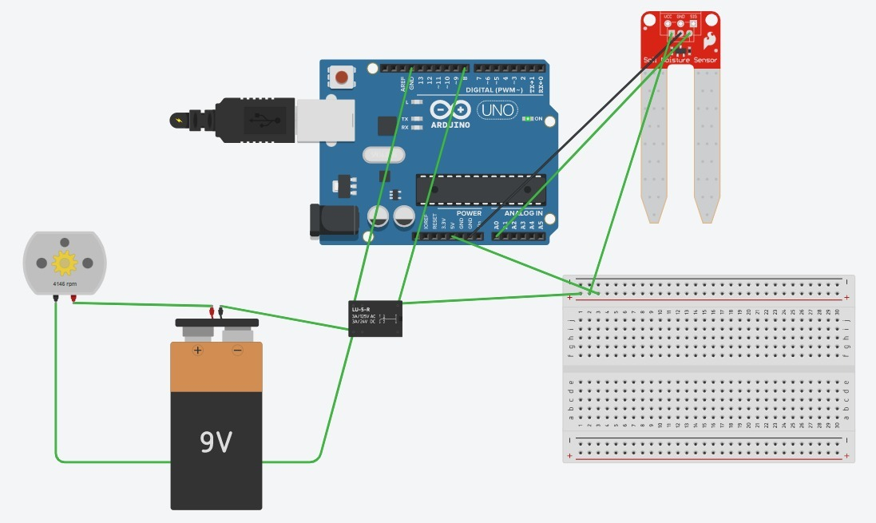
CIRCUIT SETUP

Slide 26
CODE
int m=0; // Taking a variable for soil moisture sensor
int red=2;// taking digital pin 2 for output
int blue=3;// taking digital pin 3 for output
const int buzzer = 9; //buzzer to arduino pin 9
void setup() {
// put your setcode here, to run once:
pinMode(A0, INPUT_PULLUP); //Giving input through Analog pin
pinMode(8,OUTPUT);// And output to the relay
pinMode (red,OUTPUT);
pinMode (blue,OUTPUT);
pinMode(buzzer, OUTPUT);
Serial.begin(9600);
}
void loop() {
// put your main code here, to run repeatedly:s
int value = analogRead(A1);// read the signal of water depth sensor
int m= analogRead(A0); //Read the signal
Serial.println(m);
delay(200);
if (m>=800)

Slide 27
{
digitalWrite(8, HIGH);//MOTOR ON
}
else if (m<800)
{
digitalWrite(8, LOW);//MOTOR OFF
}
if (value > 500) {
Serial.println("water there");//water in container is ok
digitalWrite (red,HIGH);//red light will glow
digitalWrite(blue,LOW);//blue light will not glow
}
else{
Serial.println("no water");//water in container is about to finish
digitalWrite (blue,HIGH);//blue light will glow
digitalWrite (red,LOW);//red light will not glow
tone(buzzer, 1000); // Send 1KHz sound signal...
delay(1000); // ...for 1 sec
noTone(buzzer);
delay(100);
}
}

Slide 28
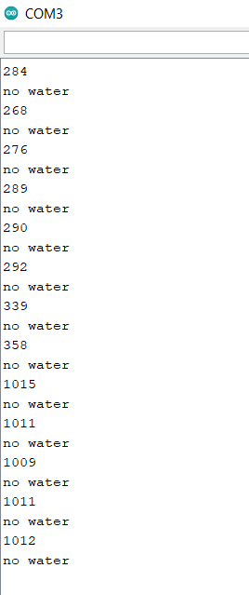
OUTPUT

Slide 29
CONCLUSION :
“AUTOMATED IRRIGTAION SYSTEM USING THE ARDUNIO” has been designed and tested successfully. It has been developed by integrating all the features of all the hardware components used. Presence of every module has been reasoned above and placed carefully in order to contribute to the best working of the unit. The system has been tested to function automatically, and to the best of its ability. The moisture sensors measure the moisture level (water content) of the different plants. If the moisture level is found to be below the desired level, the moisture sensor sends the signal to the operational amplifier which triggers the DC Motor pump to turn ON and supply the water to respective field area.

Slide 30

FUTURE EXTENSIONS :
The application certainly is much more advantageous than the manual system.
There will be no bias in the regions being covered and the delay is kept as minimal as it can be.
The operator does not require any previous training because of its user friendliness.
The operator is free from any technical issues.
Extremely simple design makes the circuit easy to implement and maintain.
Alterations in the system can be done easily if the process of the working changes in future.
In future according to the user’s requirement it can be updated to meet the user requirements.

Slide 31
THANK YOU

